Slide 1



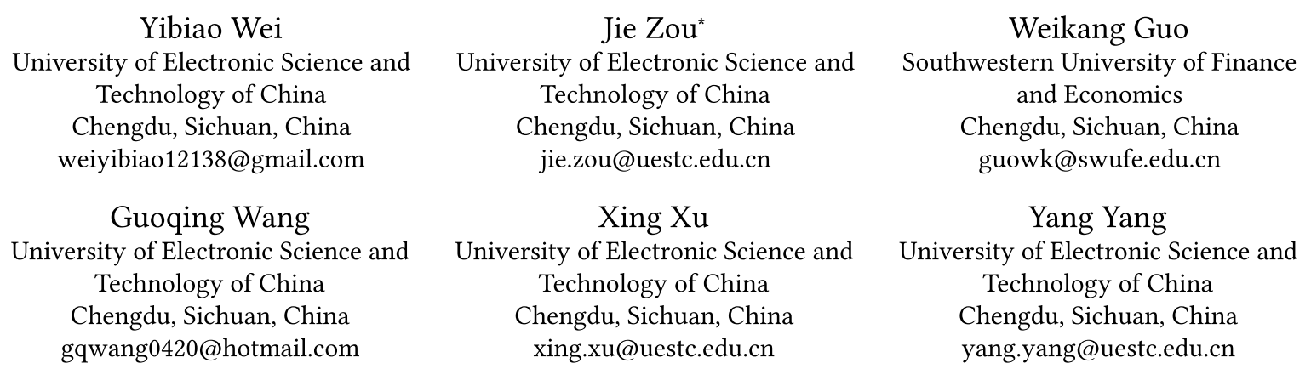





Chongqing University of Technology
ATAI
Advanced Technique of Artificial Intelligence
Chongqing University of Technology
MSCRS: Multi-modal Semantic Graph Prompt Learning Framework for Conversational Recommender Systems
Code：https://github.com/BIAOBIAO12138/MSCRS-main
2025.6.16 • ChongQing
—— SIGIR 2025
Reported by Peng Shan

Slide 2
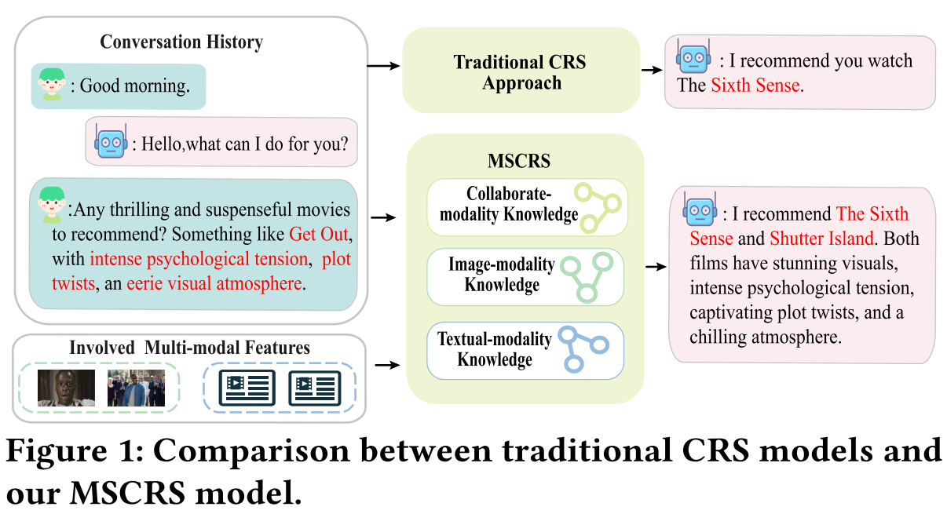
Motivation
(1) Due to the limited nature of conversational contexts (e.g.short and sparse), relying solely on extracting user preferences from conversations makes it challenging to achieve personalized modeling。
(2) It is well known that a semantic gap exists between conversational context and these external data, due to the inconsistencies in expression form and information structure between them, complicating the direct integration of different data sources。

Slide 3
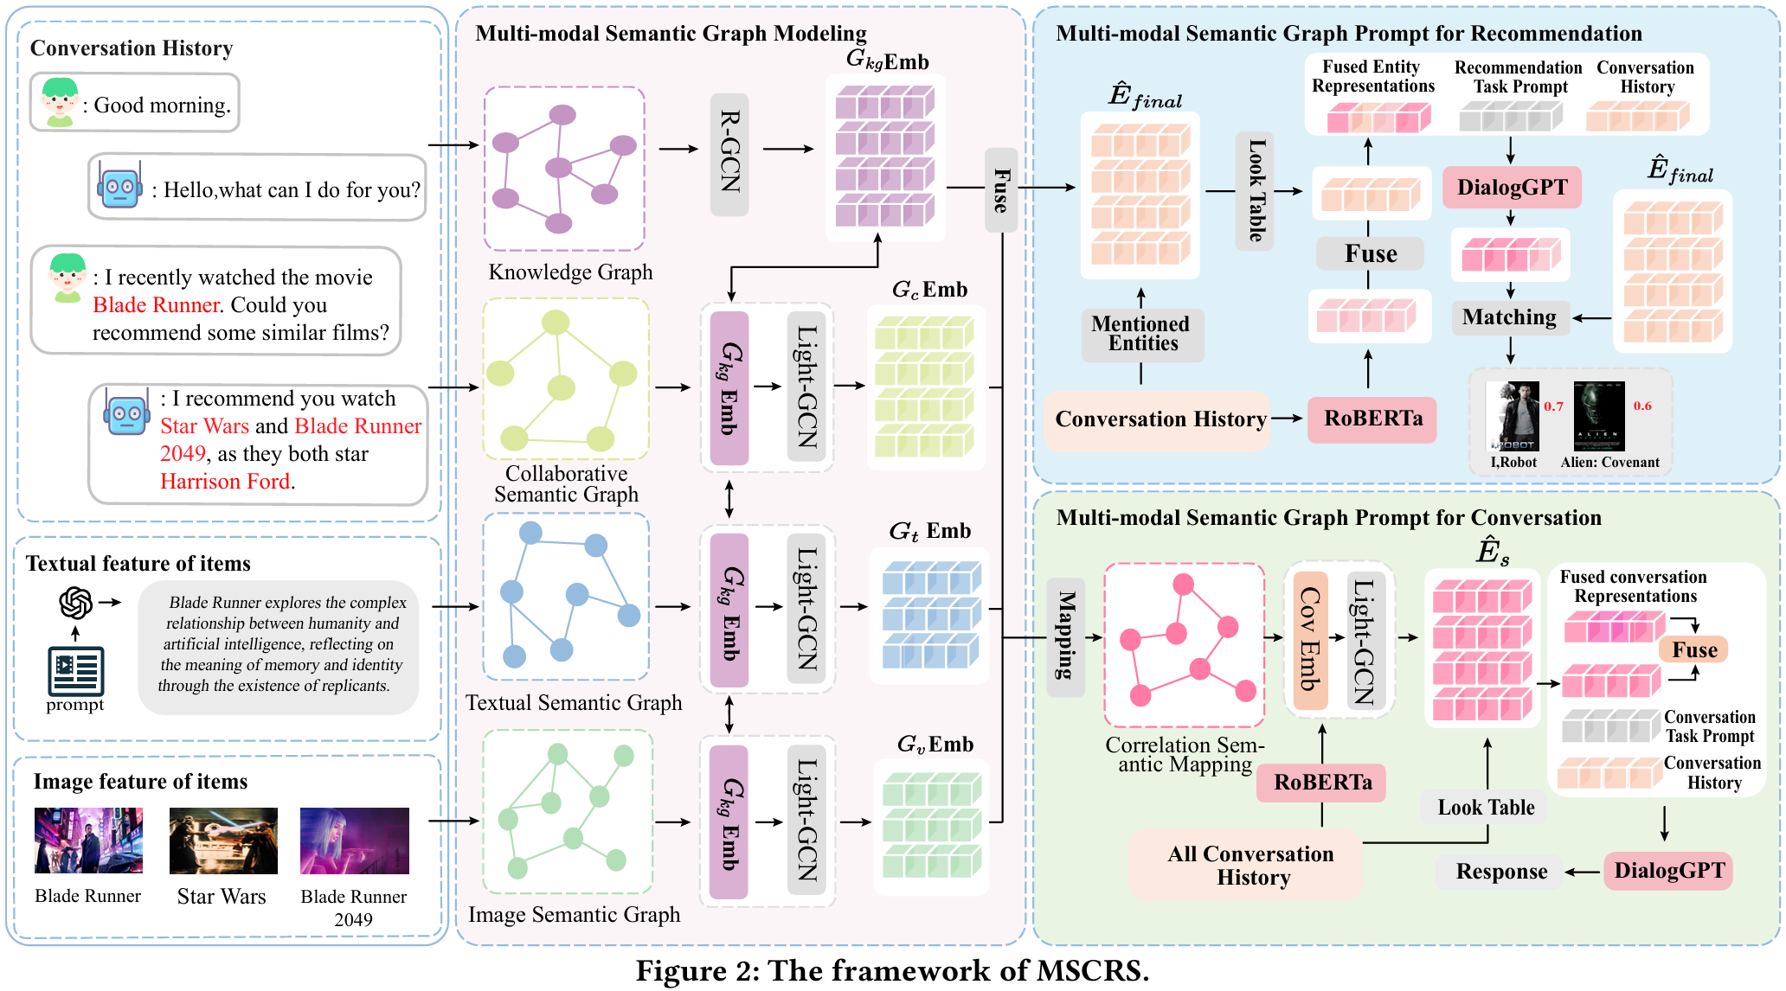
Method

Slide 4
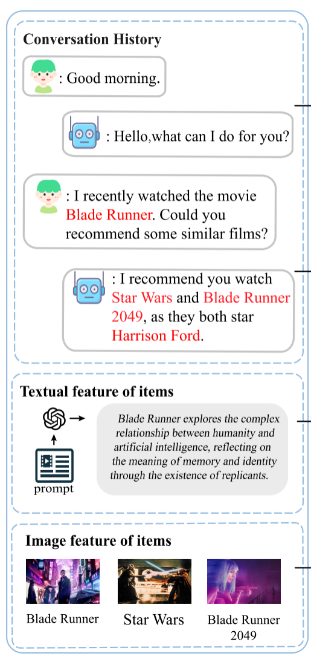

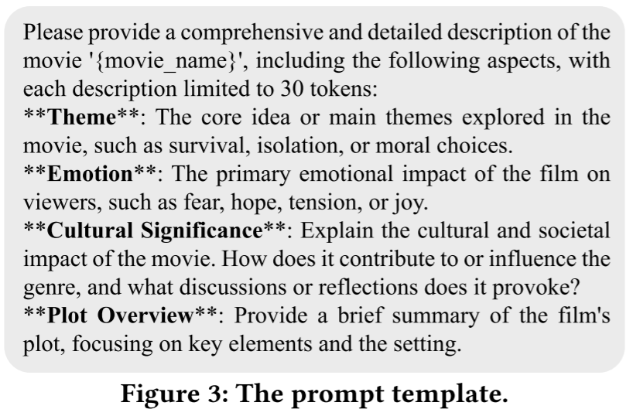


Method

Slide 5
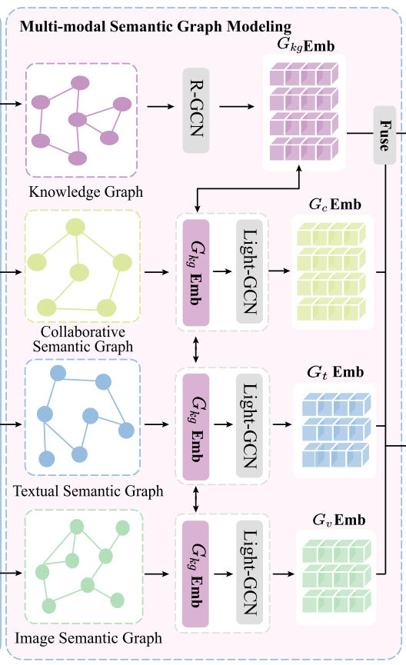
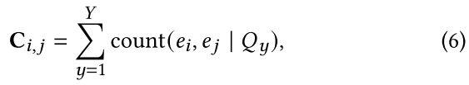


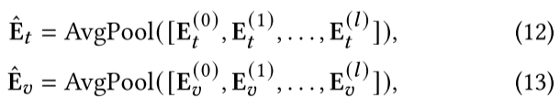



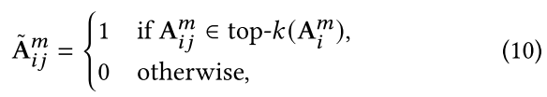
Method

Slide 6

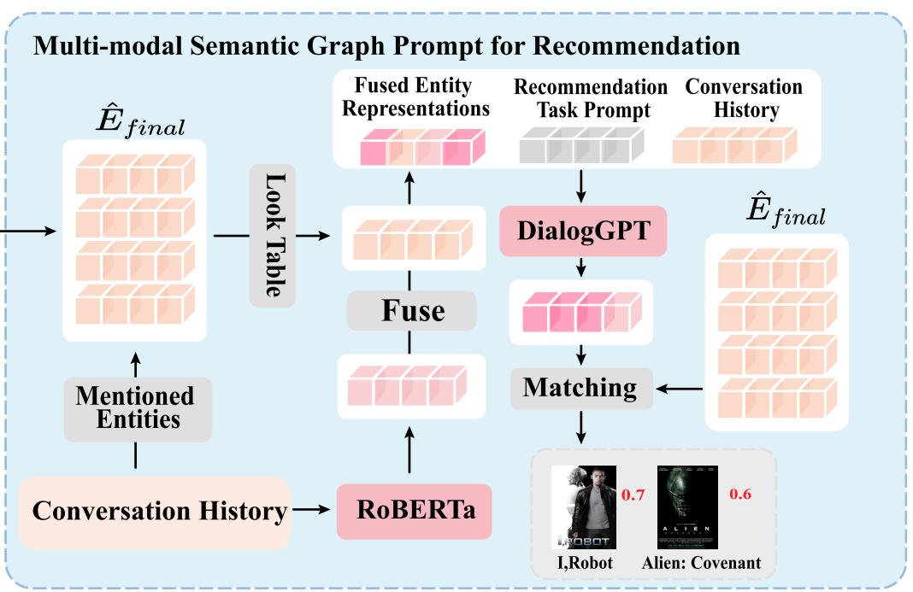
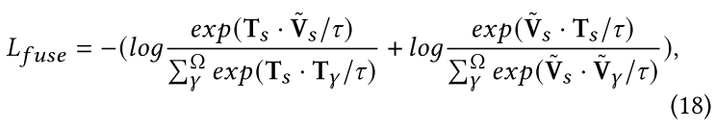


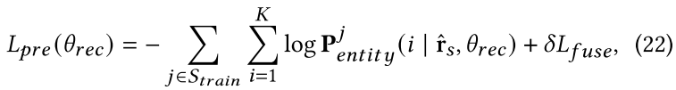
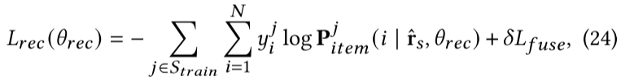
Method

Slide 7
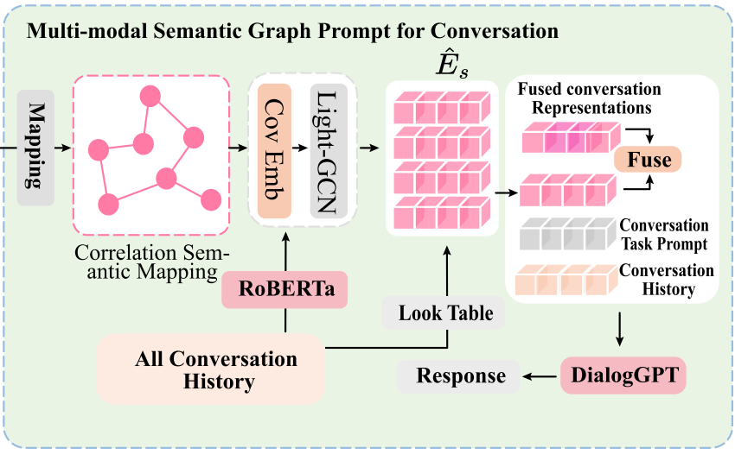





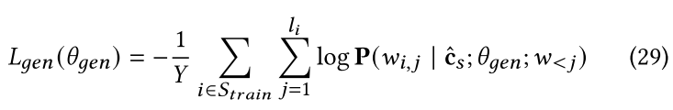
Method

Slide 8
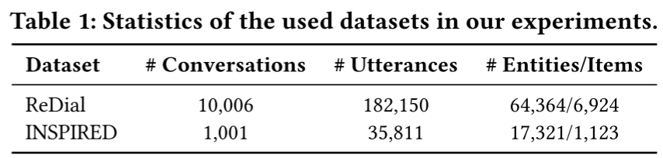
Experiments

Slide 9
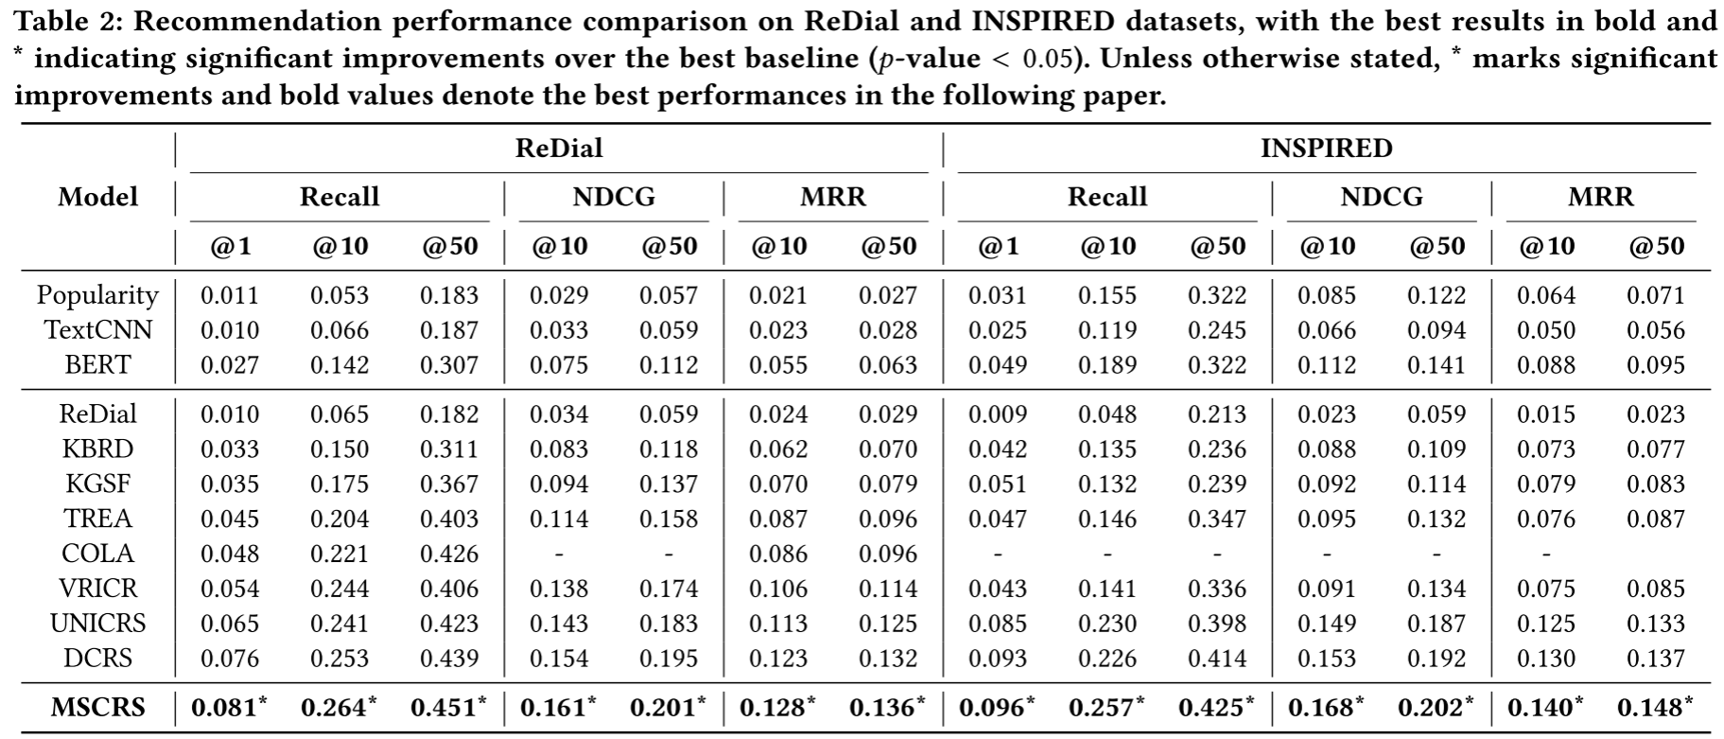
Experiments

Slide 10
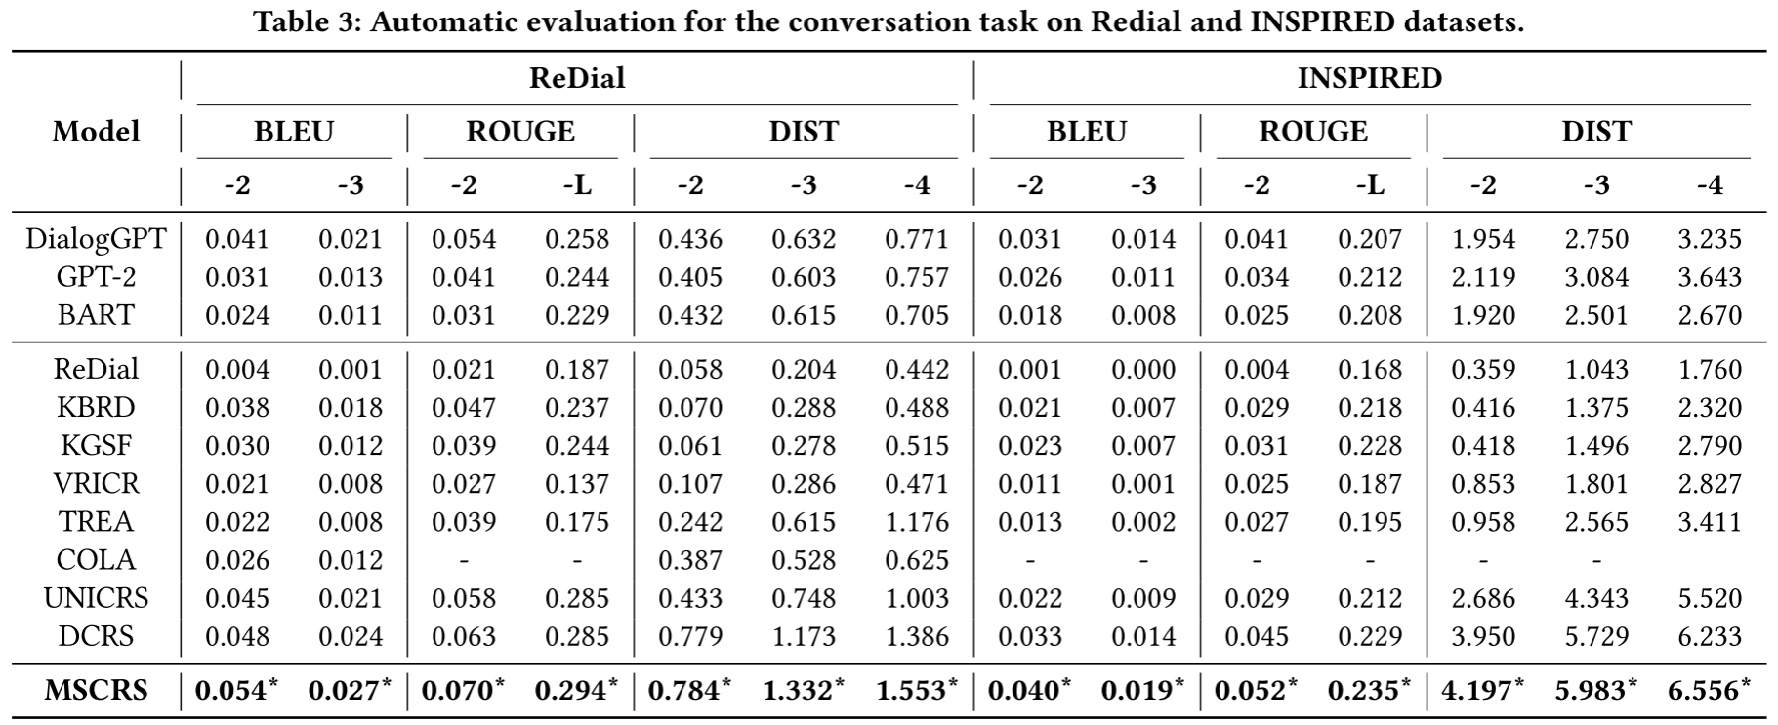
Experiments

Slide 11
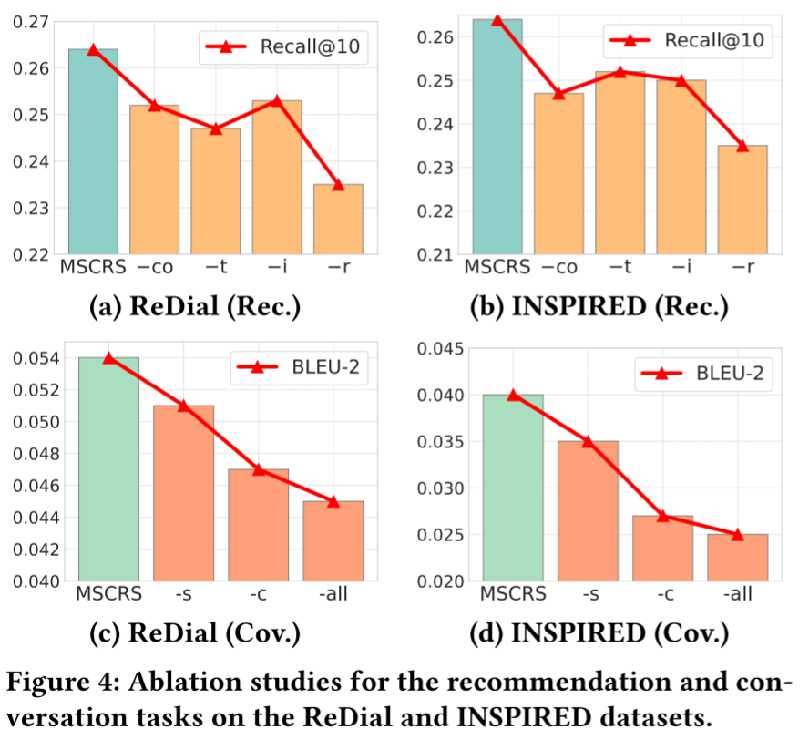
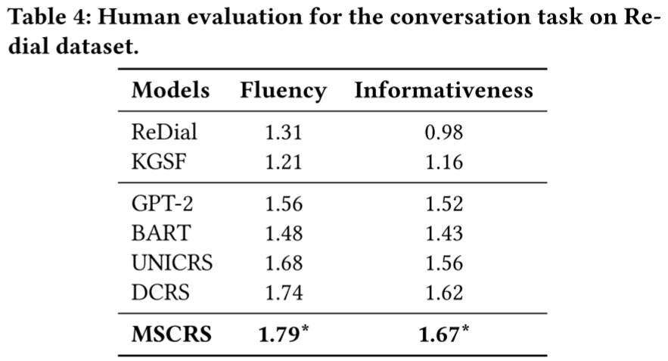
Experiments

Slide 12
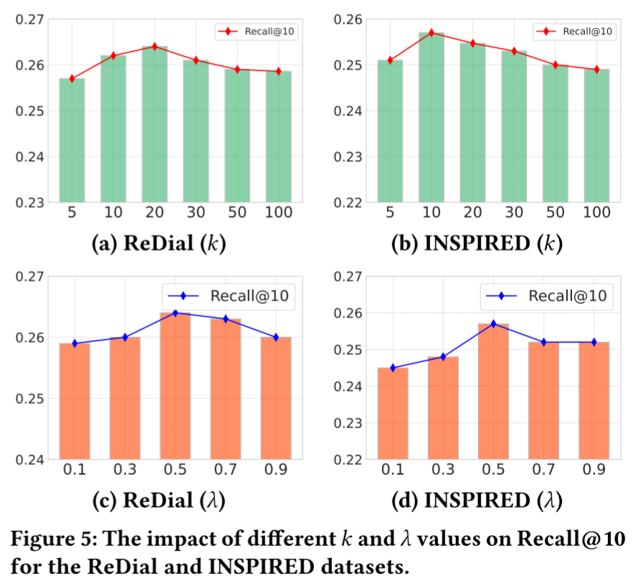
Experiments

Slide 13
Thanks!

